Slide 1
Power Test

Slide 2
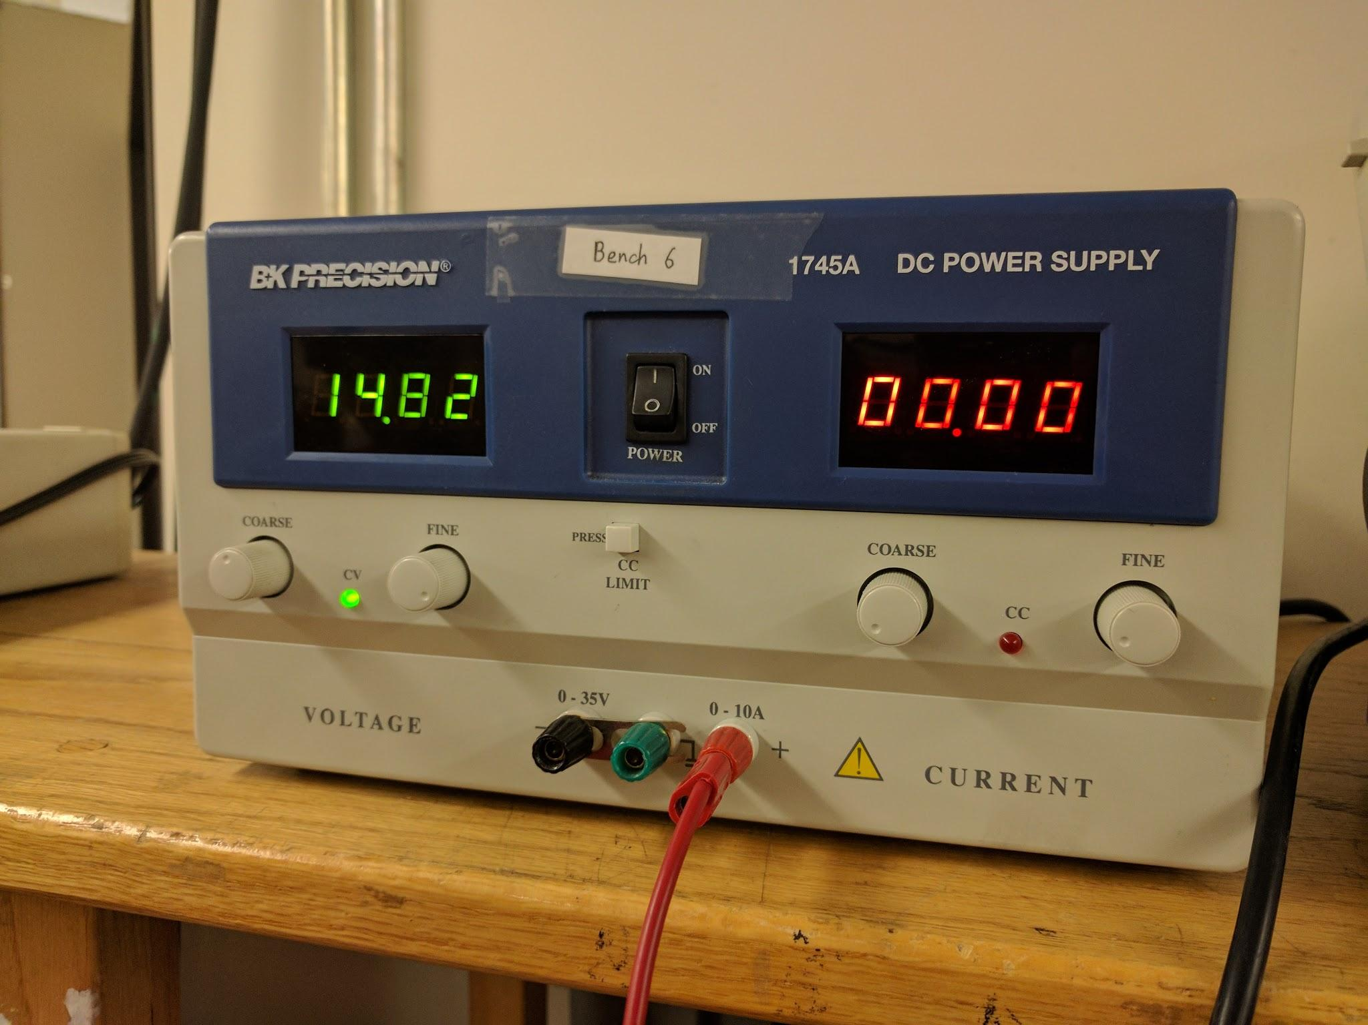

Slide 3
5V Conversion

Slide 4
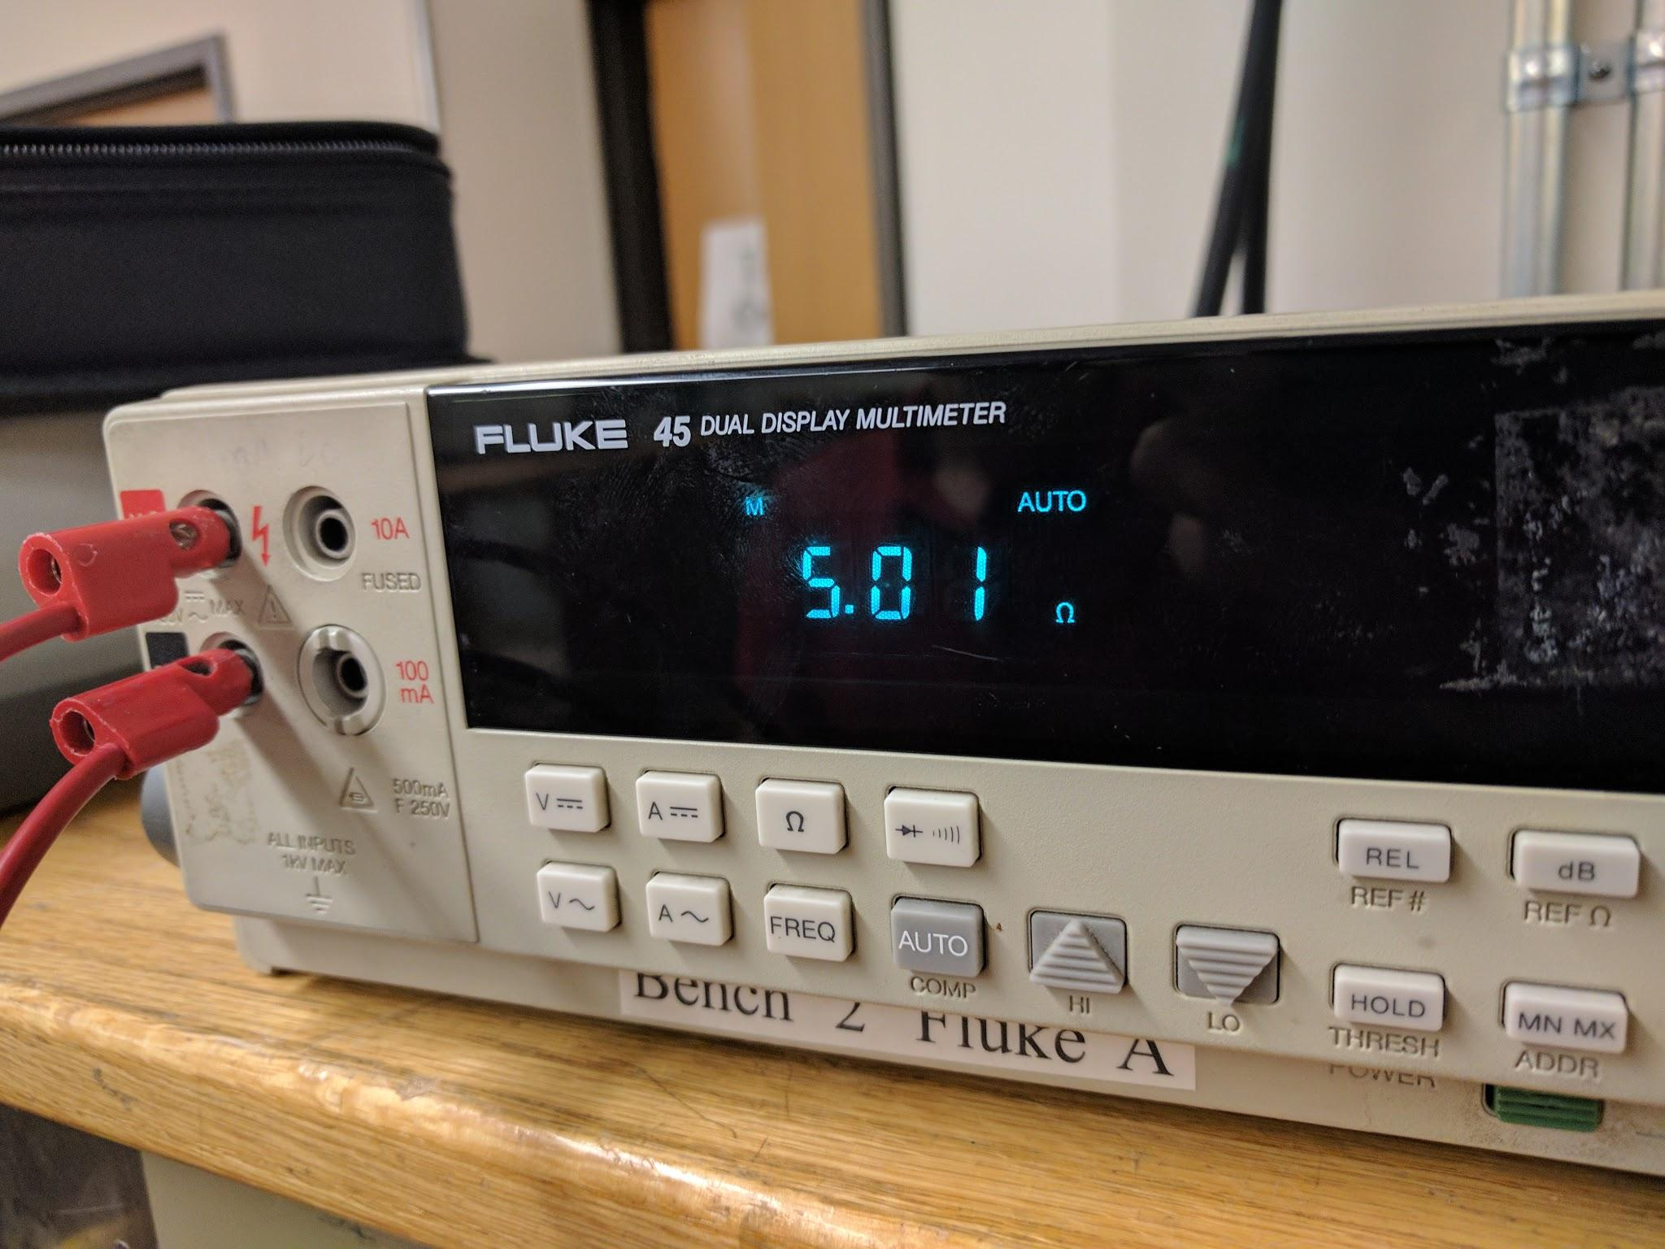

Slide 5
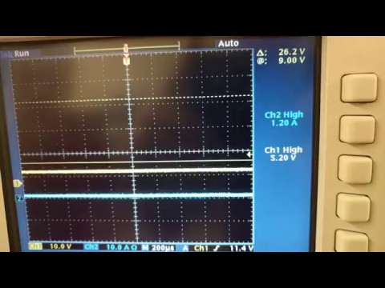

Slide 6
5V Conversion: Voltage and Current Testing
Voltage output at desired level
Current capacity above minimum design threshold.
Pass

Slide 7
12 Volt Conversion

Slide 8
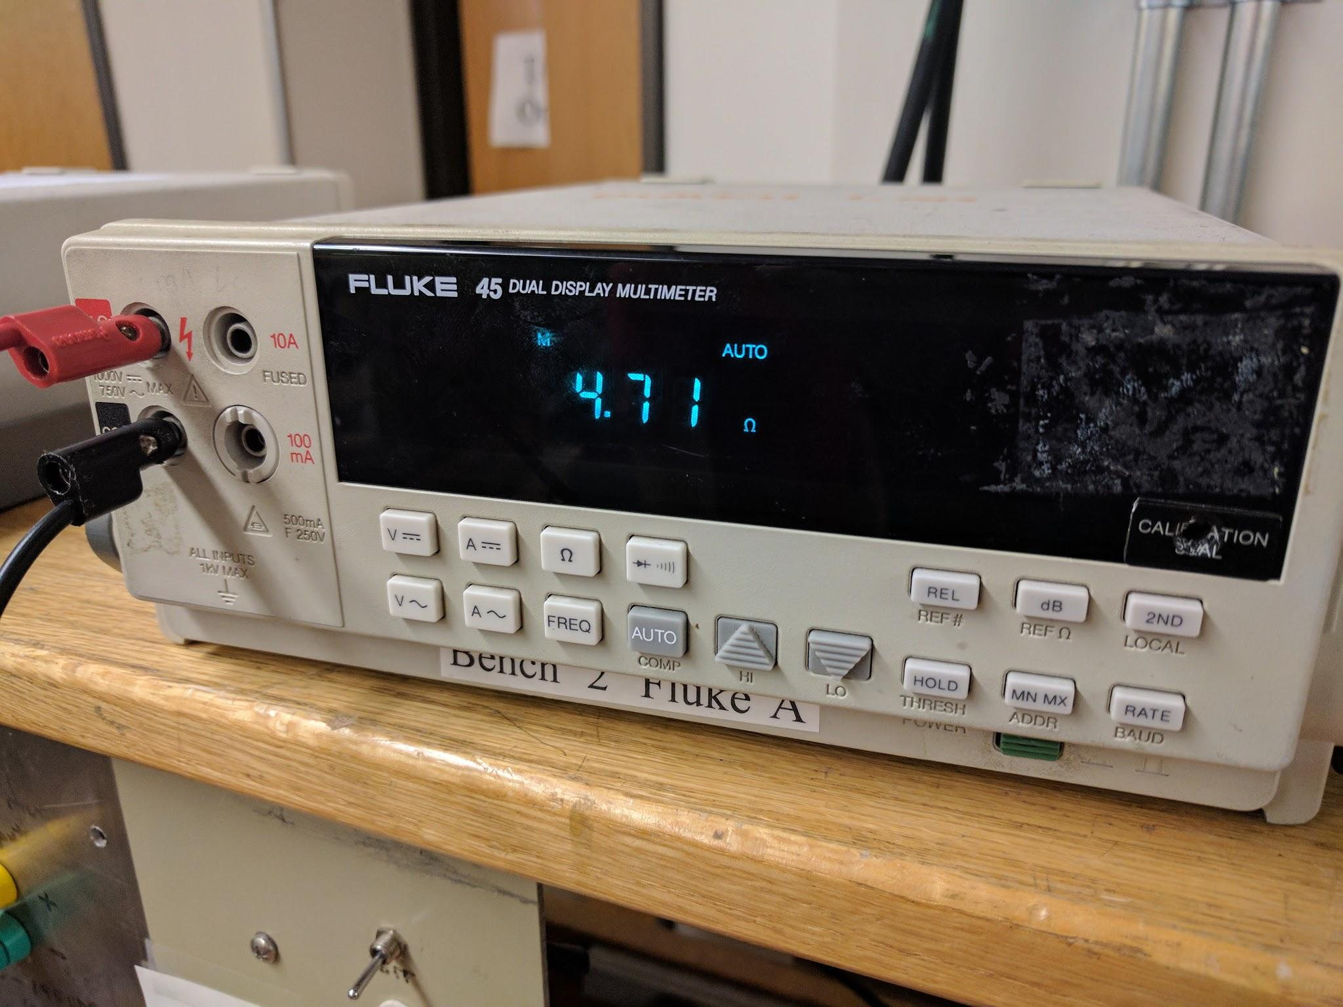

Slide 9
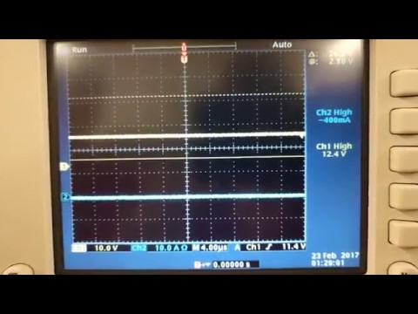

Slide 10
12 V Conversion Test: Results
Voltage level within desired range
Current capacity, insufficient.
Fails test
Reasons:
Switching MOSFET only rated for 8W.
19V test will fail for the same reason. Circuits were built the same structure with different passive component values. 19V line requires higher power rating.

Slide 11
48V, 0.5A Conversion

Slide 12
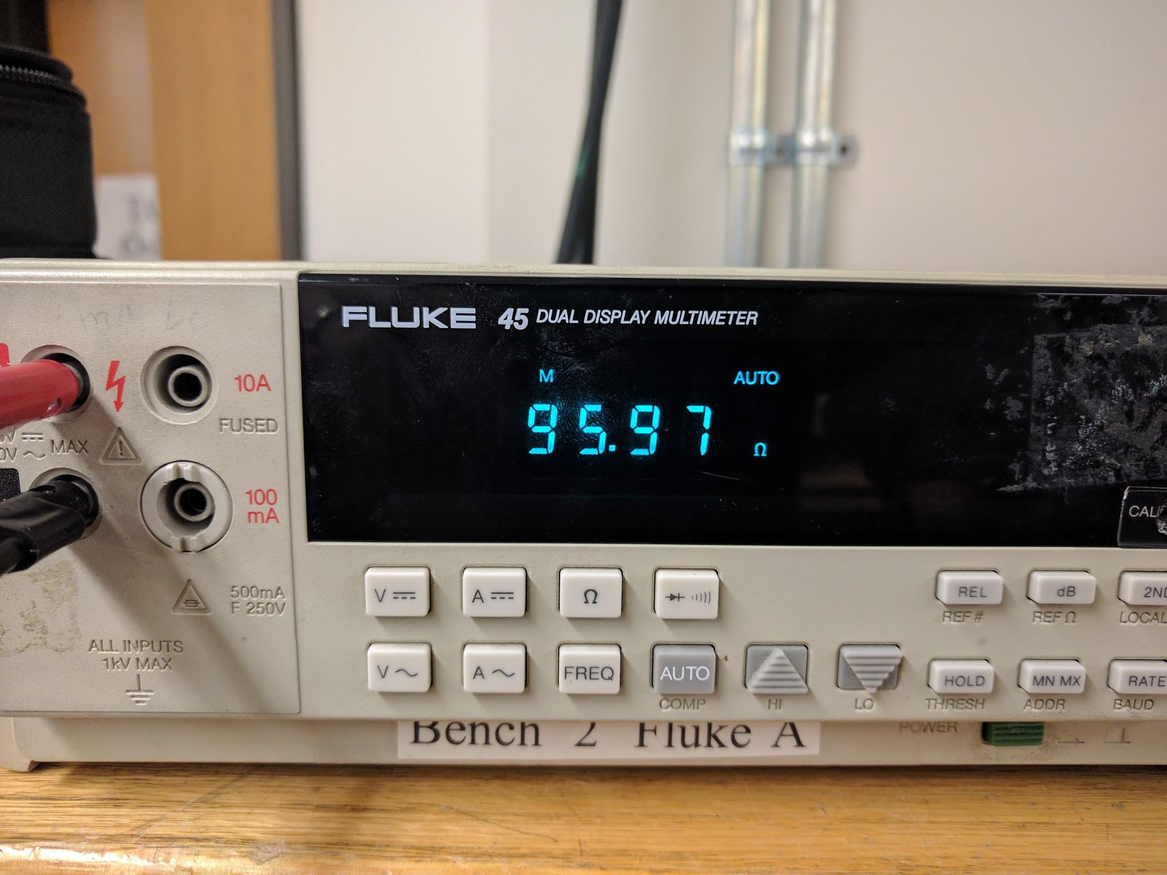

Slide 13
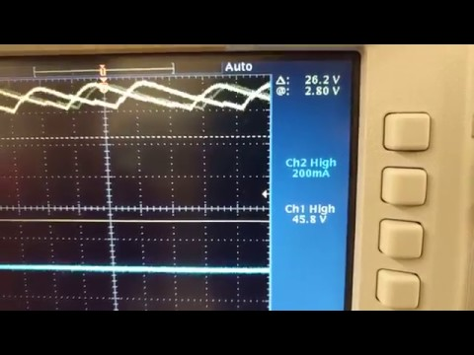

Slide 14
48V, 0.5A Conversion, Results
Current capacity lower than expected
Voltage level lower than expected

Slide 15
48V, 1A Conversion

Slide 16
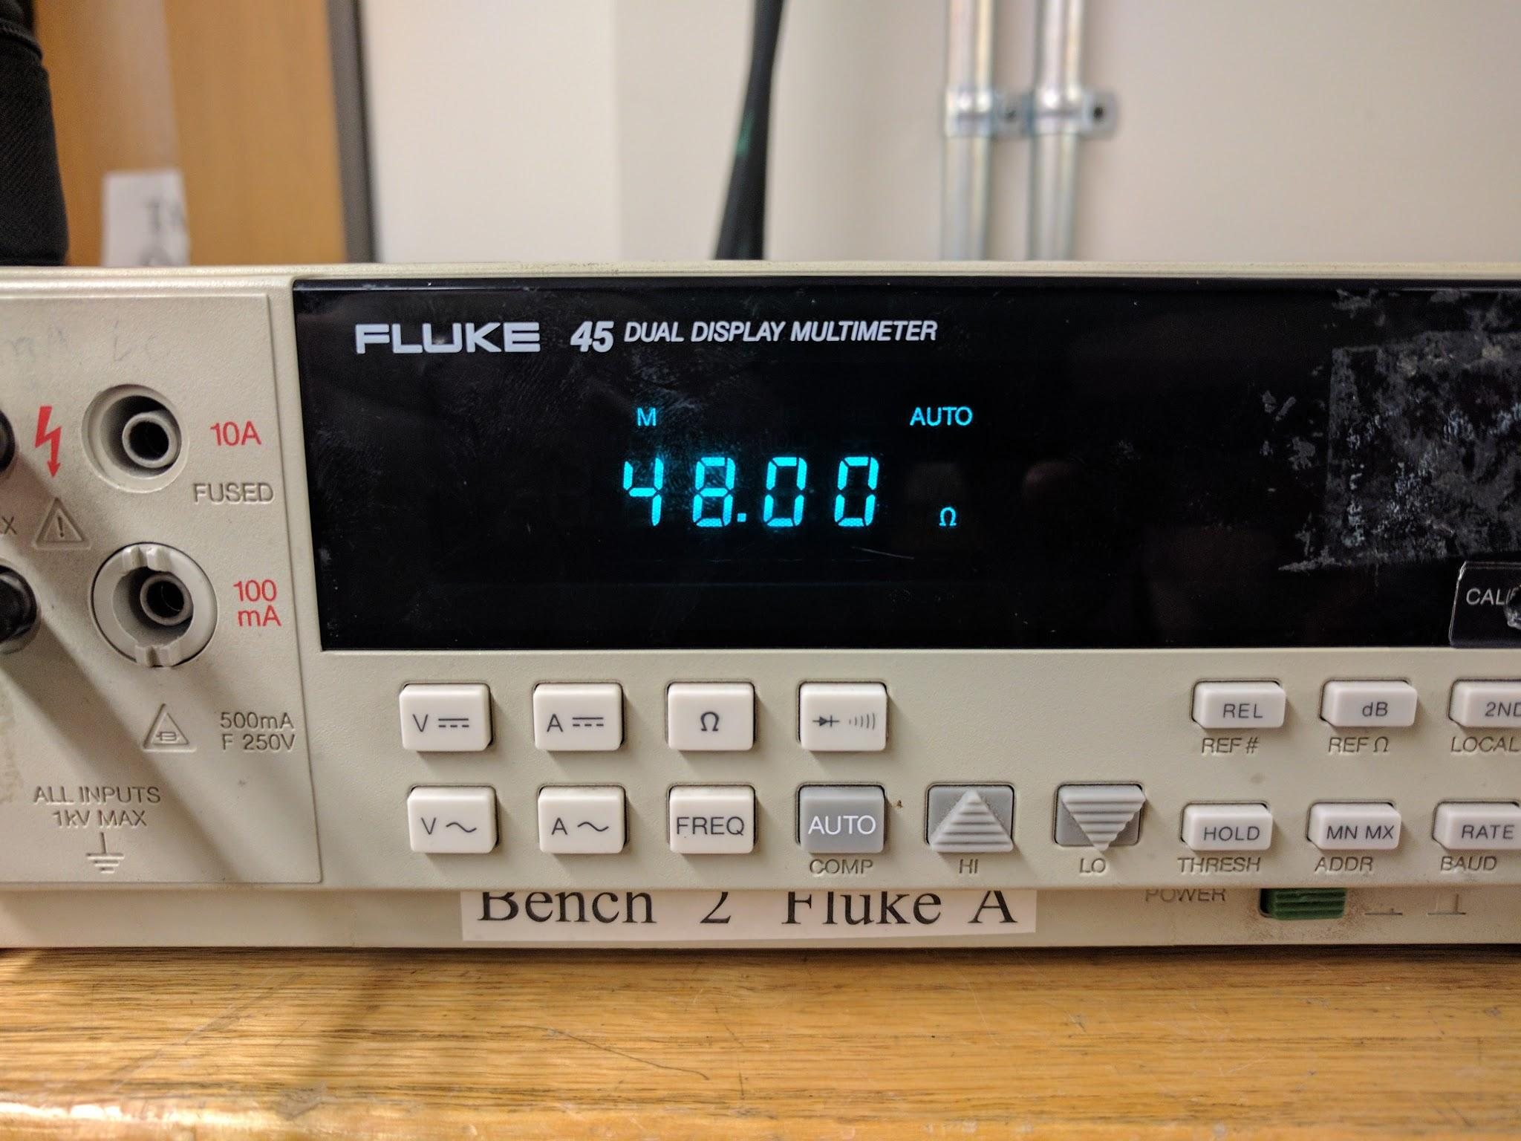

Slide 17
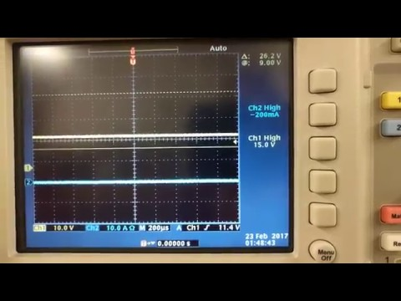

Slide 18
48V, 1A Conversion Circuit
Voltage Output: Below desired level, failed
Current Output: Insufficient
Overall: Failed

Slide 19
Questions?

